Slide 1
Computer Aided Diagnostics: A Case Study
Automated Hepatitis C Detection and Strain Identification From RFLP Gel Images
Mohammad Haris Baig
Dr. Adnan Khan
Dr. Natasha Nabi

Slide 2
Goals
Detecting Hepatitis C
Identifying Hepatitis C Strain

Slide 3
Objectives
Speed
Accuracy
Reliability
Interactivity

Slide 4
Goals
Detecting Hepatitis C
Identifying Hepatitis C Strain

Slide 5
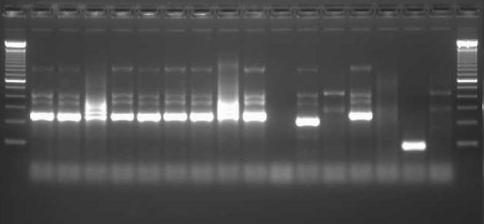
Detecting Hepatitis C
An Image of a G2 Gel

Slide 6
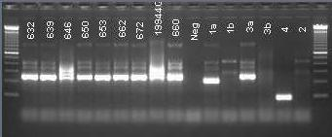
Labeled Gel Image
A Labeled Image of the Lanes

Slide 7
Enhancing Contrast
1% Saturation based Enhancement

Slide 8
Lane Detection
Lane Detection on G2 Image
Results From our Lane Detection Algorithm

Slide 9
Band Detection
Binarization based on Thresholding

Slide 10
Band Localization

Slide 11
Reporting Results
For Each Patient:
For Each Strain:
Matching is based on
Number of Bands Found
Number of Bands Expected
Location of Bands Found
Location of Bands Expected
For Each Patient:
Display Highest Percentage Match Strain Name and Matching Percentage

Slide 12
Goals
Detecting Hepatitis C
Identifying Hepatitis C Strain

Slide 13
Hepatitis C Strain Identification
An Image of a DE Digest Gel

Slide 14
The Problem
To Identify And Match Banding Patterns
In Each Lane to
a Banding Pattern
produced by a Hep-C Strain

Slide 15
Main Issues
Low Resolution Images
High Degree of Noise
High Degree of Variability in Image Quality
Lack of Standardization of Procedure
Tilted Bands
Smeared Bands / Merged Bands
Broken Bands

Slide 16
Low Resolution of Images
74 by 292 Pixels
Enhanced size
(Loss of Data)
- Left Side Ladder Lane
370 by 98 Pixels
Original Image
- Sample Image for Test
Notes:
If Image Size is Standardized, then our User may not have to enter the Number of Lanes
(A Great Benefit for Batch Processing)

Slide 17
High Degree of Noise
Notes:
Better Quality Images lead to avoiding Issues of handling Noise Reduction and Signal Purification and concentrating on task of Matching.
Also they reduce the burden on the Identification Algorithm

Slide 18
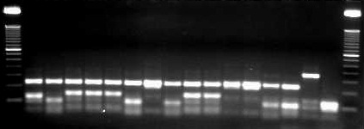
High Degree of Variability in Image Quality
Sample 1
Sample 2
Notes:
High Degrees of Contrast Adjustment to guarantee accurate band detection.

Slide 19
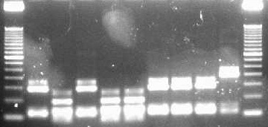
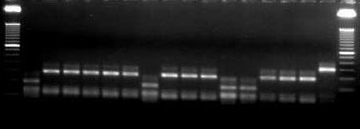
Lack of Standardization of Procedure
Sample 1
Sample 2
Sample 3
Notes:
Leads to Redundancy in Data entry (Big cause of Human Error)

Slide 20
Tilted Bands
A Problem for Accurate Band Center Detection
Notes:
Incorporate Inaccuracy in Model on Detection of Precise location of Bands

Slide 21
Smeared Bands/ Merged Bands
Notes:
Harder Identification of Individual Bands

Slide 22
Broken Bands

Slide 23
How to Solve These Problems

Slide 24
Detecting Lanes

Slide 25
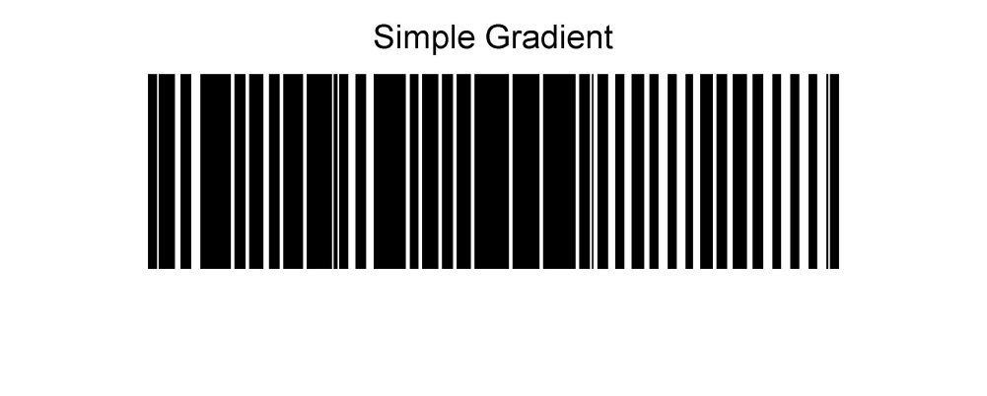
Detecting Lanes – How to
Too many vertical lines due to Broken Band’s Effects
Notes:
What to do about Broken Bands?
Does this suggest an E-M Iterative style algorthim?

Slide 26
Detecting Lanes

Slide 27
Detecting Lanes

Slide 28
Band Detection
Input Image

Slide 29
Band Detection

Slide 30
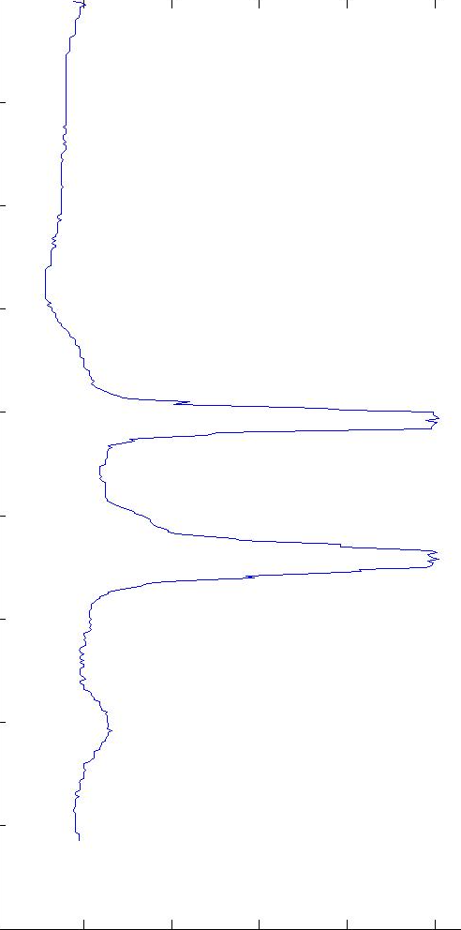
Band Indentification - How to?
Image Reconstructed from Median Profile
Median Based Profile for Each Row

Slide 31
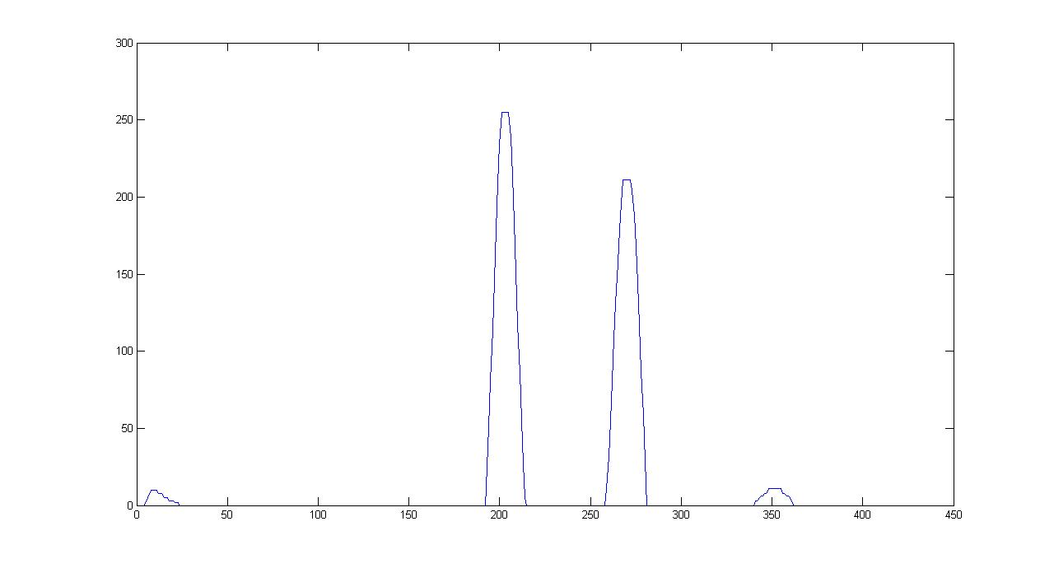
Band Identification - How to?
Results from Morphological Filtering, Top Hat Filter

Slide 32
Bands Detection

Slide 33
Ladder Calibration
Using Pre calibrated Ladder
To interpolate the missing bands

Slide 34
Reporting Results
For Each Patient:
For Each Strain:
Matching is based on
Number of Bands Found
Number of Bands Expected
Location of Bands Found
Location of Bands Expected
For Each Patient:
Display Highest Percentage Match Strain Name and Matching Percentage
Display Original Image
Display Processed Image with marked bands
Highlight any unusual Bands Found.

