Slide 1
Automated Hepatitis-C Nodule Detection
MOHAMMAD HARIS BAIG

Slide 2
The Problem
- Identification of Hepatitis C Nodules from a sequence of such Images of Slices of Lungs

Slide 3
Approach
- Denoising of Images for increasing Accuracy
Lung Detection from Denoised Images
Enhancing Features Inside the Lungs
Iteratively Segmenting More Detailed Features
3D Display of Features

Slide 4
Overview
Image Normalization
Denoising
Segmentation
Feature Enhancement
Iterative Segmentation
Automatic Lung Detection
3D Reconstruction

Slide 5
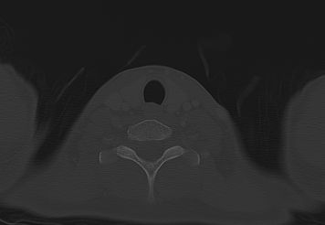
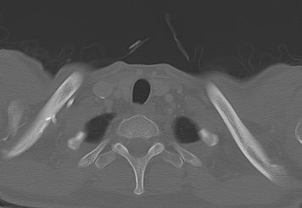
Image Normalization
The Problem:

Slide 6
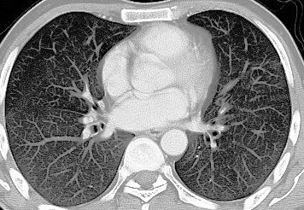
Image Normalization
Solutions
X
Histogram Equalization
Histogram Matching

Slide 7
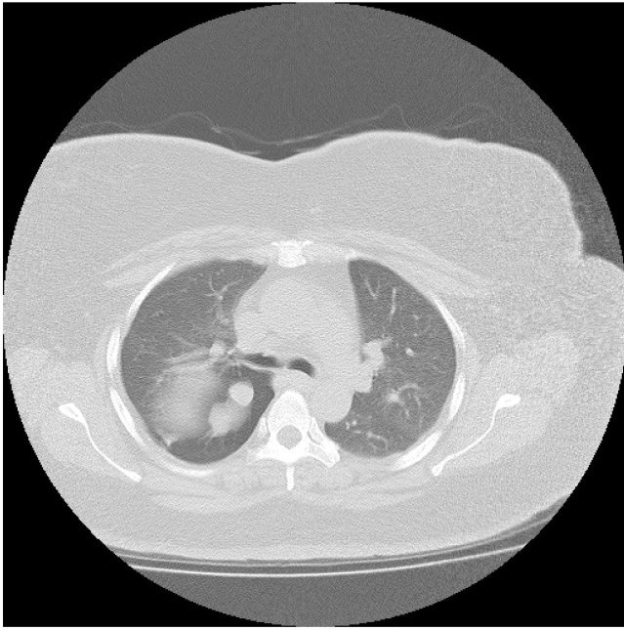
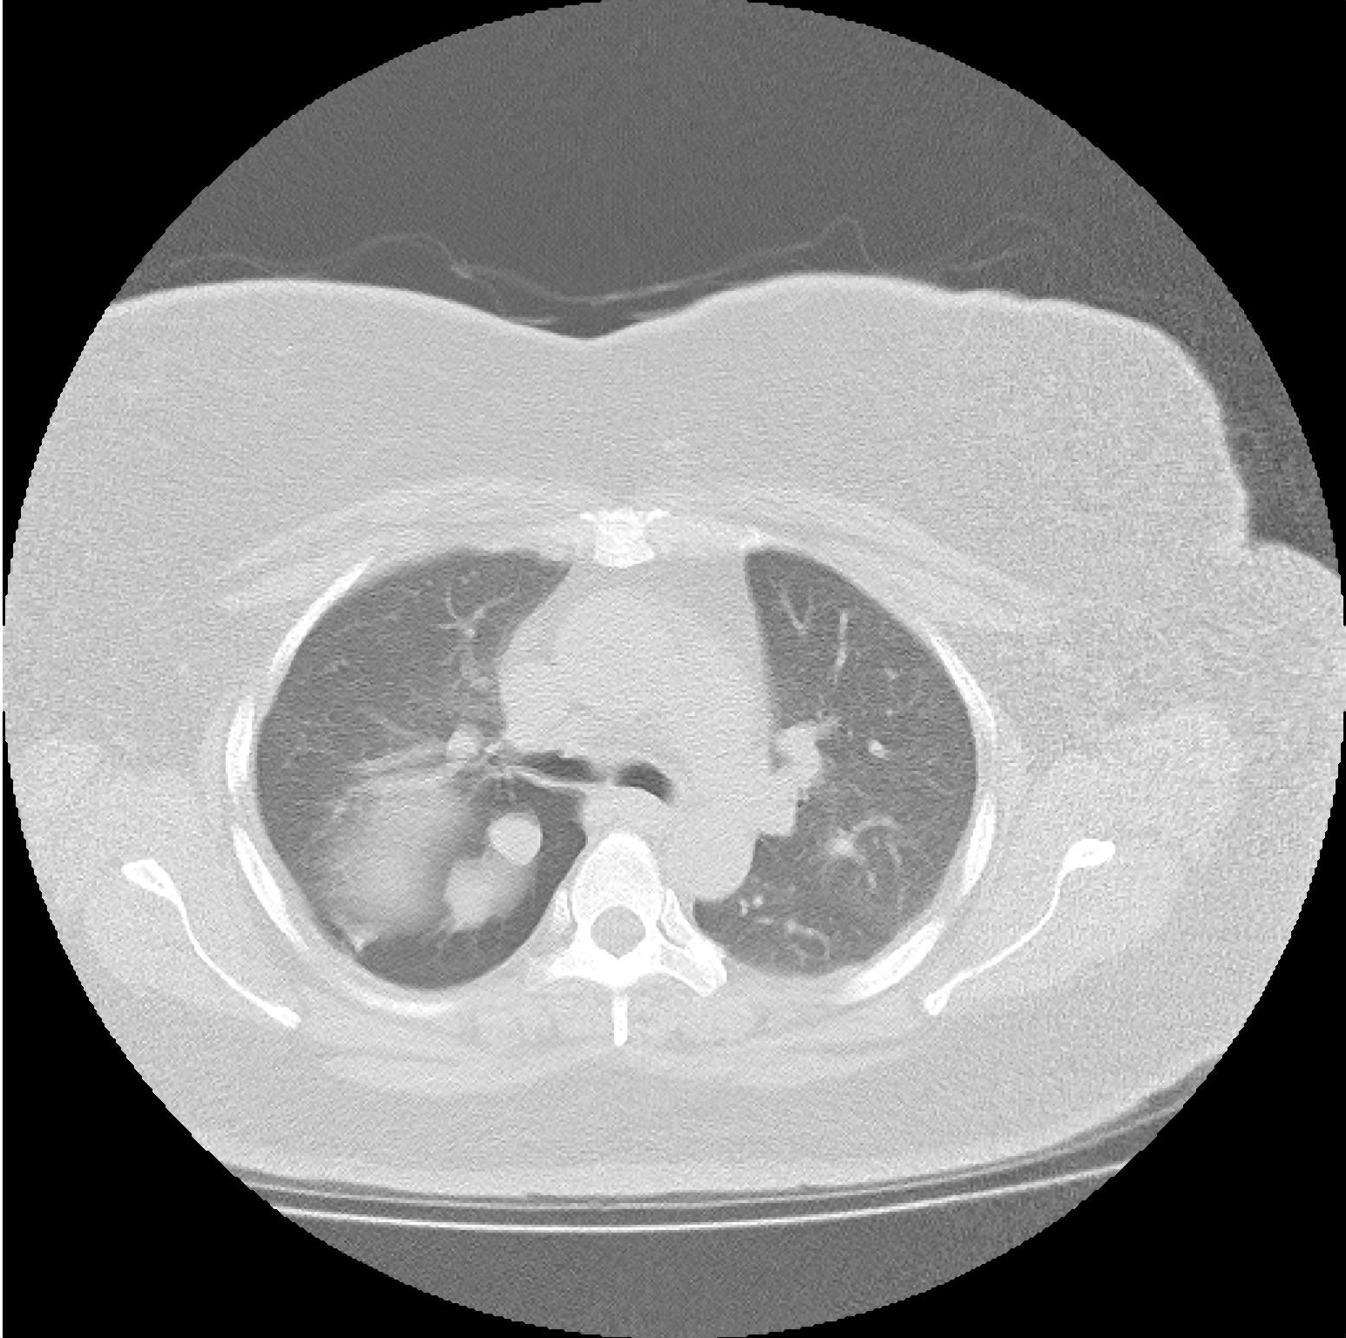
Denoising - 1
Original Image
Median Filtering

Slide 8
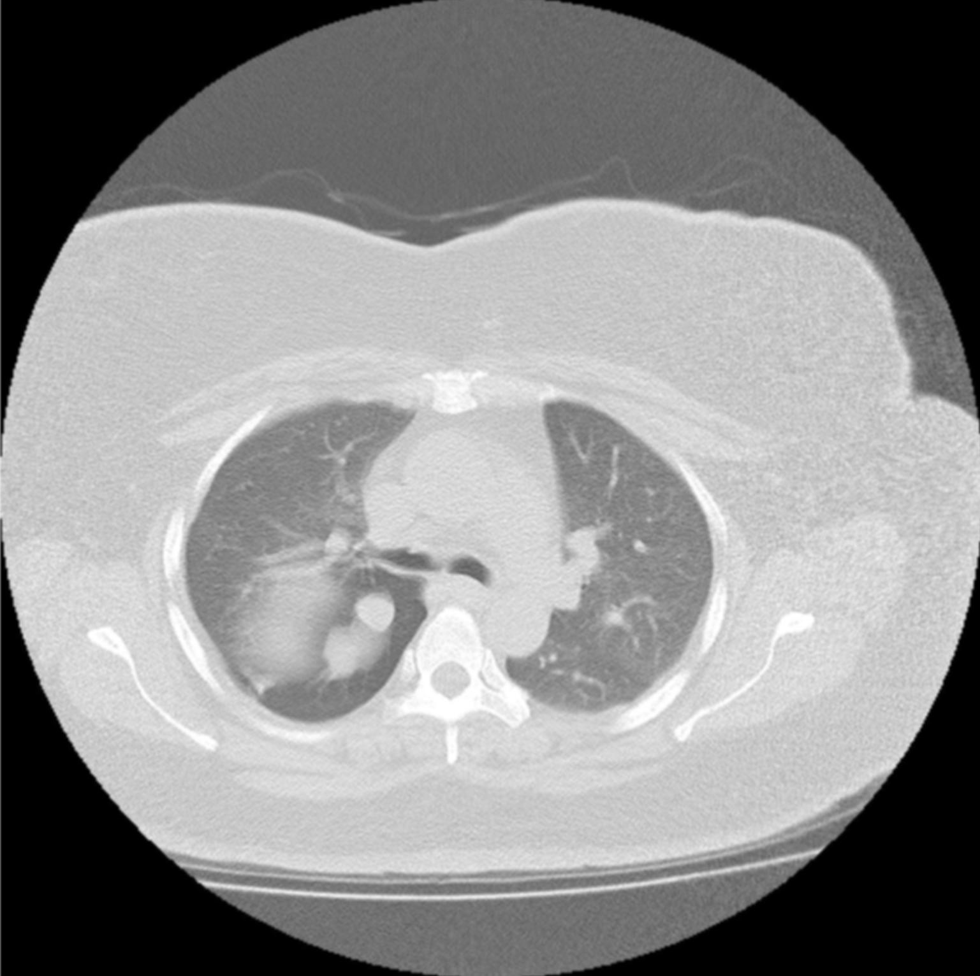
Denoising - 2
Original Image
Mean Filtering

Slide 9
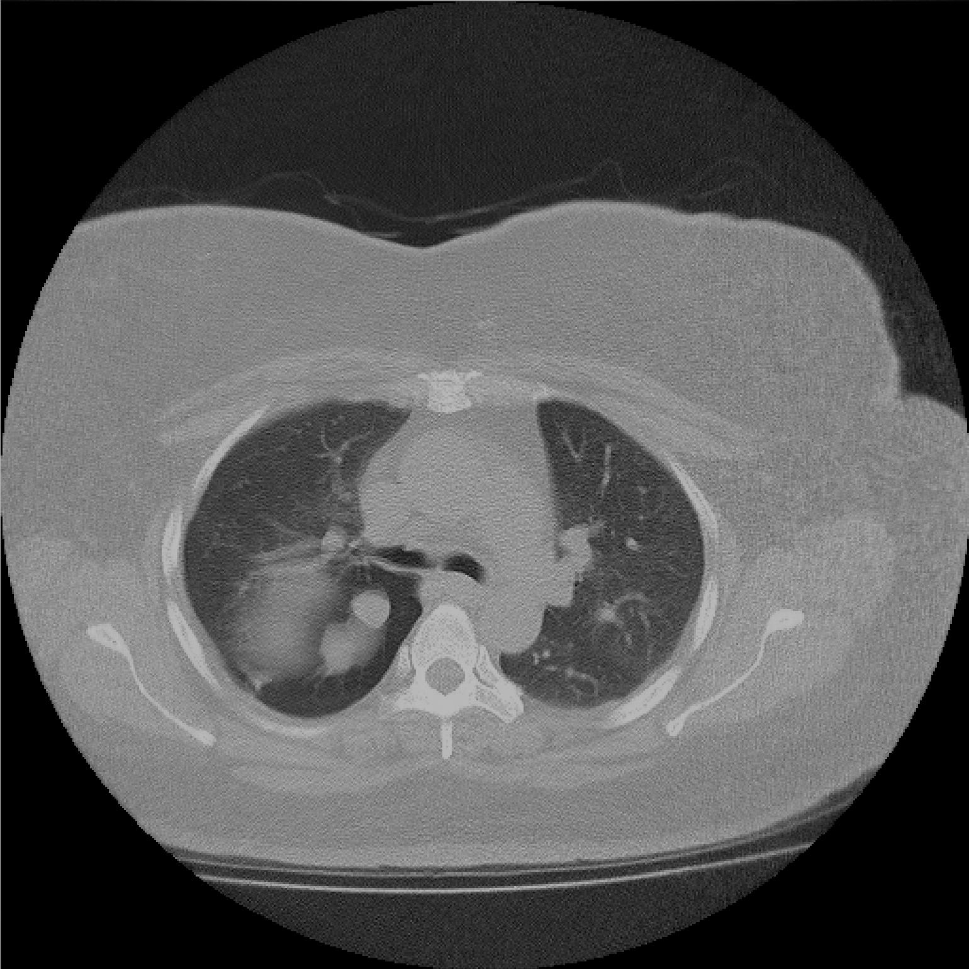
Denoising - 3
Original
Image
Fourier
Transform
Low
Pass Filter
Final Image

Slide 10
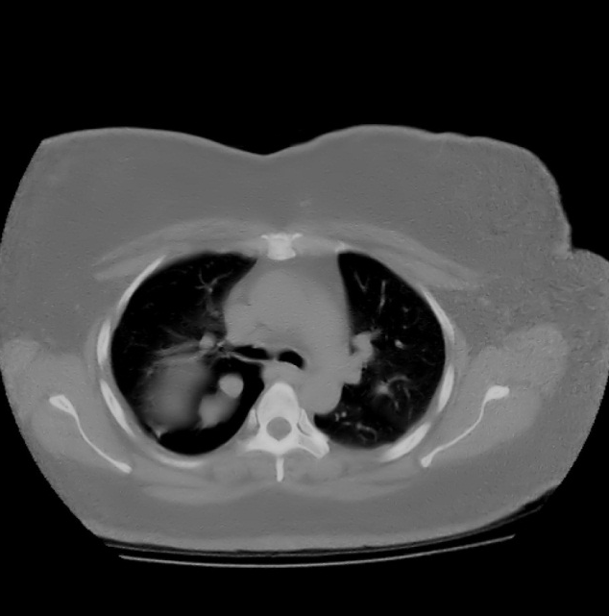
Denoising - 4
Original Image
Non Orthogonal
Wavelet Based
Noise Reduction

Slide 11
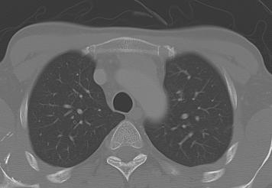
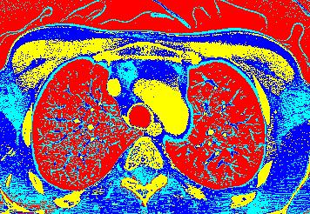
Segmentation
Original Image
K Means Based Clustering

Slide 12
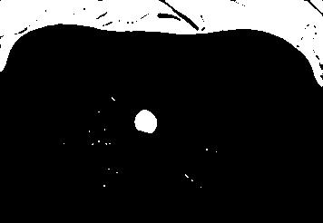
Segmentation - 1
Original Image
Trachea

Slide 13
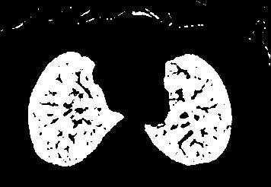
Segmentation - 2
Original Image
Lungs

Slide 14
Segmentation - 3
Original Image
Bones

Slide 15
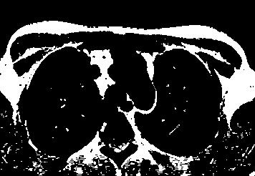
Segmentation - 4
Original Image
Muscles?

Slide 16
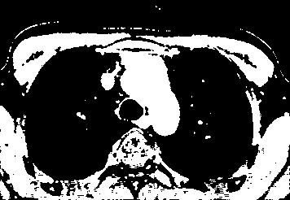
Segmentation - 5
Original Image
Muscles?

Slide 17
Automatic Lung Detection
Results after Segmentation
Sorted By Mean across each slice
Lungs = Min (Mean)
RIBS = Max(Mean)
Rows Contain Means for different Bins from K Means
Cols Contain all the Bins for a Slice

Slide 18
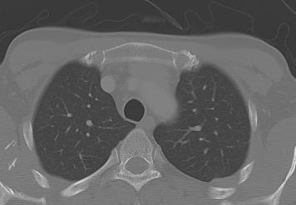
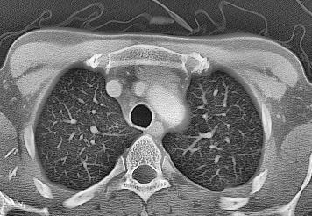
Feature Enhancement - 1
Original Image
Adaptive Histogram Equalization

Slide 19
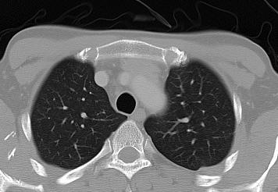
Feature Enhancement - 2
Original Image
Saturation Based Enhancement

Slide 20
Feature Enhancement - 3
Original Image
Combination
Saturation Based &
Adaptive Histogram Equalization

Slide 21
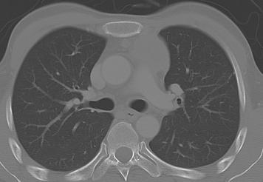
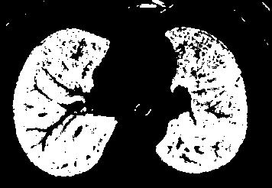
Iterative Segmentation
Original Image
Binary Mask
Extracted Lungs
And then Re-apply K Means Clustering

Slide 22
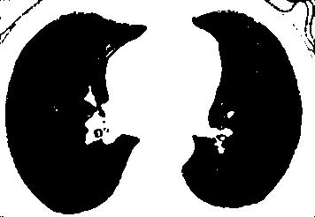
Iterative Segmentation - 1
Extracted Lungs
Background

Slide 23
Iterative Segmentation - 2
Extracted Lungs
Inner Lung
Major Structures

Slide 24
Iterative Segmentation - 3
Extracted Lungs
Lung Boundary Structures

Slide 25
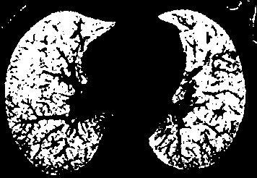
Iterative Segmentation - 4
Extracted Lungs
Lung Internal
Bacground

Slide 26
3D Reconstruction
3D Reconstructions are done by Stacking Contours of Segmented Regions

Slide 27
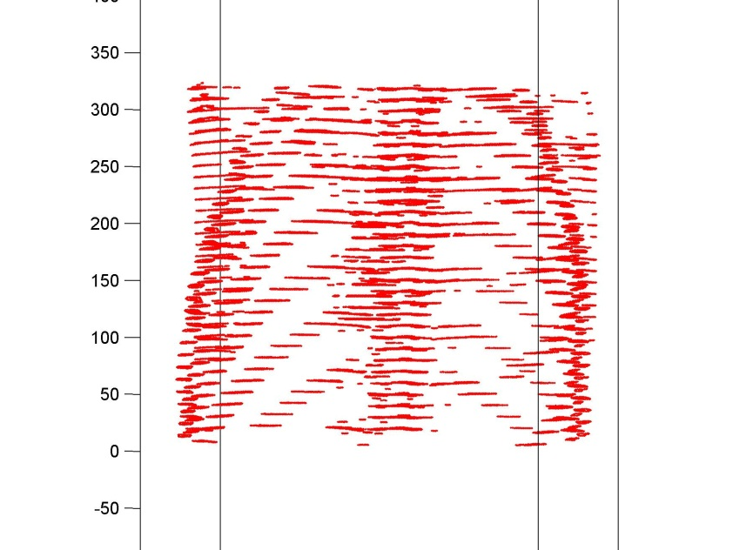
3D Reconstruction- RIBS

Slide 28
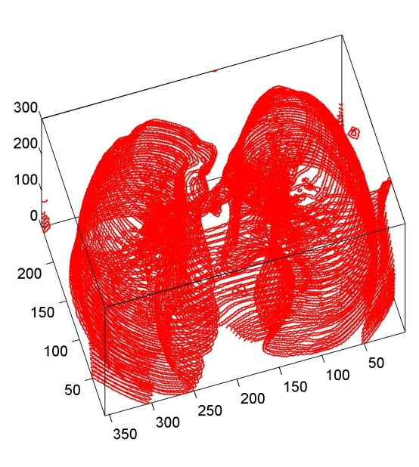
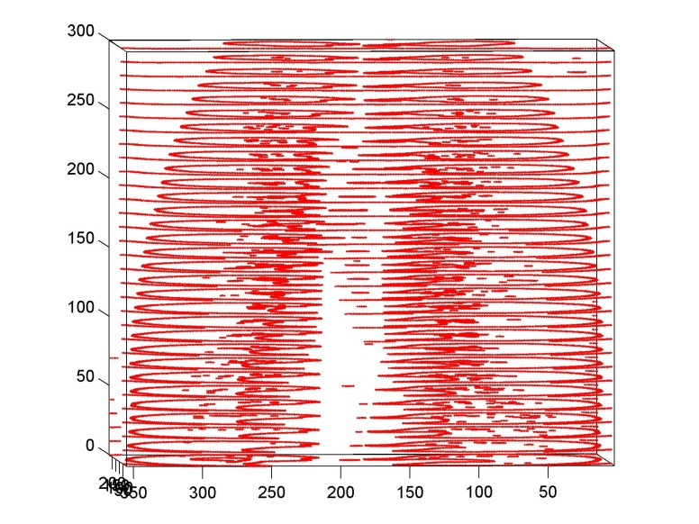
3D Reconstruction- LUNGS

Slide 29
Final Output

